Slide 1
How to Access the Example Canvas Course
Create a sandbox course using the Canvas Utilities webpage or use an existing sandbox if you have one
Open the sandbox course
In the right-hand menu, select "Import from Commons"
In the top search bar, search for "Canvas Accessibility Demo" and click on the title of the course
In the right-hand menu, click on "Import/Download"
Click the box next to the name of your sandbox
Scroll to the bottom and select "Import into Course"
Notes:
Ash

Slide 2
Canvas Accessibility Building Inclusion through Digital Accessibility Series
Clarisa Almazan (she/her) & Ash Mitchell (they/them)
Notes:
Clarisa

Slide 3
Learning Objectives
Explore digital accessibility features in Canvas
Notes:
Clarisa

Slide 4
Why make your Canvas course accessible?
Improves student learning
Particularly supports the large and growing number of students with disabilities
Improves retention
Inclusive environment
It's the law
Notes:
Clarisa

Slide 5
Please ask questions in the chat!

Slide 6
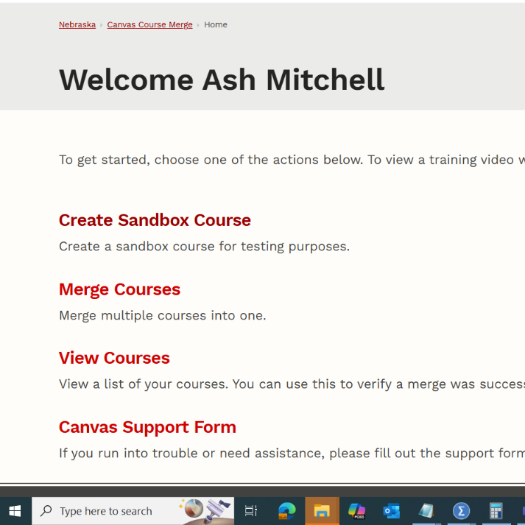
Create a Sandbox Course in Canvas
Go to the Canvas Utilities webpage
Log in using your UNL credentials if needed
Click on "Create Sandbox Course"
Write the course name and click "Submit"
Open the sandbox
In the left-hand side global navigation panel. Click on either:
"Dashboard"
Sandbox will be at the bottom underneath unpublished courses
Courses
Then select "All Courses" and click on your sandbox
Notes:
Ash

Slide 7
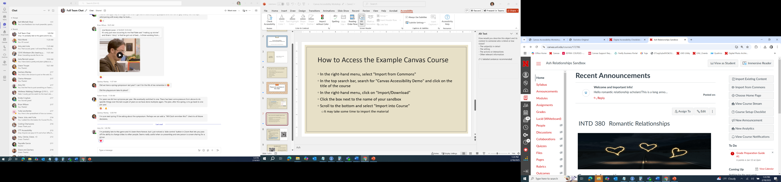
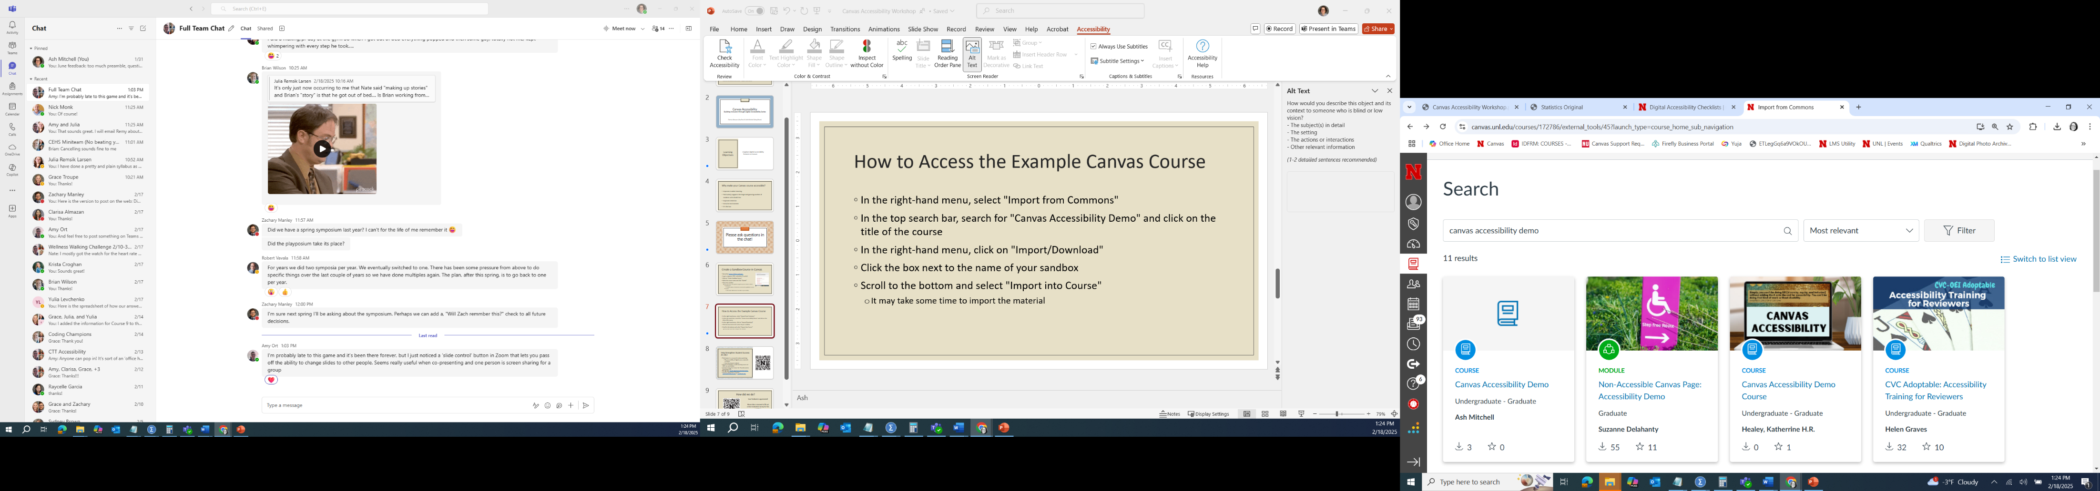
Importing the Example Canvas Course
In the right-hand menu, select "Import from Commons"
In the top search bar, search for "Canvas Accessibility Demo" and click on the title of the course
In the right-hand menu, click on "Import/Download"
Click the box next to the name of your sandbox
Scroll to the bottom and select "Import into Course"
It may take some time to import the material
Notes:
Ash

Slide 8

Accessibility Checklist
Open the Digital Accessibility Checklist for Commonly Used Programs
Canvas Checklist is also available

Slide 9
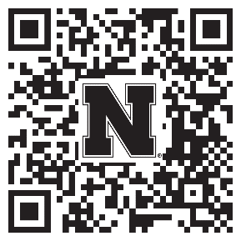
Help Strengthen Student Success At UNL!
Participate in a research study examining:
The accessibility of digital course materials in Canvas
How they impact students
Anyone teaching a credit-bearing course at UNL can participate
Conducted by the Center for Transformative Teaching (CTT)
To sign up: go.unl.edu/coursedesignstudy
Unsure? Questions? Contact amitchell22@unl.edu or aort@unl.edu
Notes:
Ash
Because of your interest in promoting your students’ success, I wanted to invite you to participate in a research study examining the accessibility of digital course materials in Canvas and how they impact students. Anyone who teaches a credit-bearing course at UNL is eligible to participate. Participation can take 5 minutes to an hour, depending on your level of participation. The go link, QR code, and contact information for the lead investigators are on the screen if you would like to learn more or participate.

Slide 10
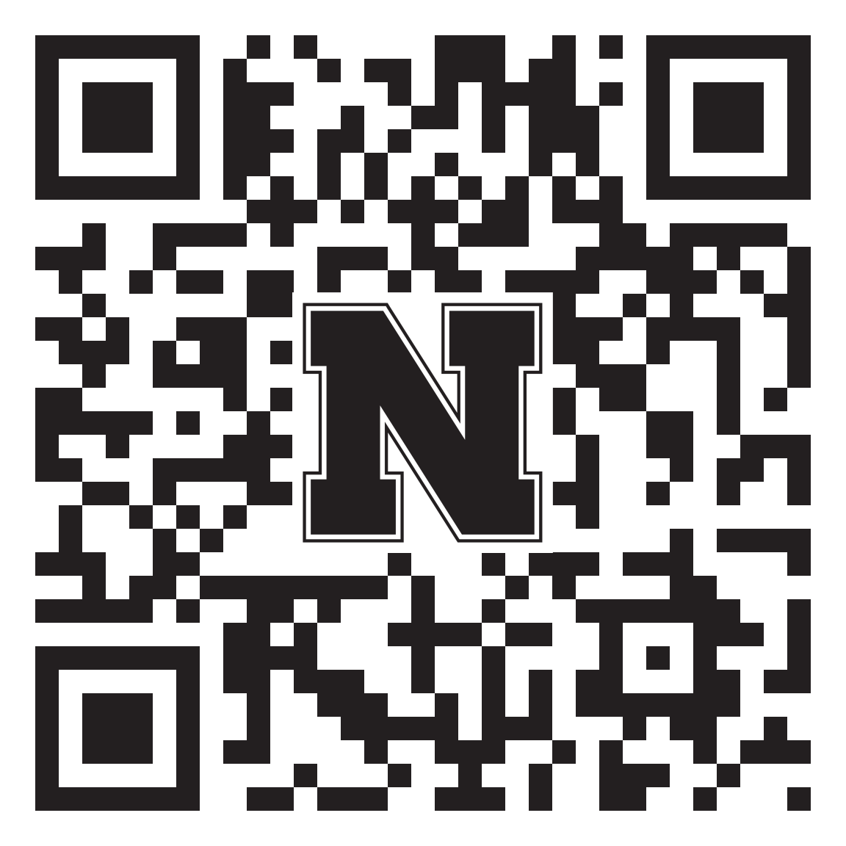
How did we do?
Your feedback is appreciated!
Please take a moment to fill out a short evaluation survey for this workshop:
go.unl.edu/bidacanvas
Notes:
Clarisa – Add question

Slide 11

Questions?

